Slide 1
Secure Data Hiding in Image Using Steganography
CAPSTONE PROJECT
Presented By:
Student Name : Tejas Jayanand
College Name : BMS College of Engineering
Department : Computer Science and Business Systems

Slide 2
OUTLINE
Problem Statement
Technology used
Wow factor
End users
Result
Conclusion
Git-hub Link
Future scope

Slide 3
Problem Statement
Modern communication demands secure data transmission. Traditional encryption methods can be vulnerable to detection and compromise. Steganography, the art of hiding data within other data, offers a potential solution.
This project aims to develop a robust steganographic system that effectively conceals sensitive information within digital images while ensuring high security and resilience against detection and tampering

Slide 4
Technology used
Modules and Libraries Used
1. OpenCV (cv2) : Used for image processing tasks, including reading and writing images. In your code, it handles the loading of the image and saving the modified image after embedding the secret message.
Installation: ”pip install opencv-python”
2. Tkinter : A built-in Python library for creating graphical user interfaces (GUIs), utilized for file selection dialogs
Installation: ”pip install tk”
3. OS : Provides a way to interact with the operating system. In your code, it is used to open the encrypted image file after it has been created.
4. String : Although not explicitly used in your code, it can be helpful for string manipulation tasks. In your case, it could be used for handling characters or creating character sets.

Slide 5
Wow factors
Graphical User Interface (GUI) for File Selection: The code utilizes Tkinter to provide a user-friendly graphical interface for selecting image files. This enhances usability by allowing users to navigate their file system visually rather than typing paths manually.
Error Handling and User Feedback: The code includes error handling for scenarios such as image loading failures. This ensures a smoother user experience by providing clear feedback and preventing crashes.

Slide 6
End users
Ethical Hackers:
Use: To test the robustness of security systems by attempting to hide data within files and assess the ability of detection systems.
Reason: To identify vulnerabilities in systems and improve security measures.
Government Agencies and Intelligence Organizations:
Use: To securely transmit classified information and communications.
Reason: To maintain confidentiality and protect national security interests.
Media and Content Creators:
Use: To embed copyright information or digital watermarks within images, audio, or video files.
Reason: To protect intellectual property and assert ownership.
Corporate Entities:
Use: To secure proprietary information and trade secrets by embedding them in non-sensitive files.
Reason: To prevent industrial espionage and protect competitive advantages.

Slide 7
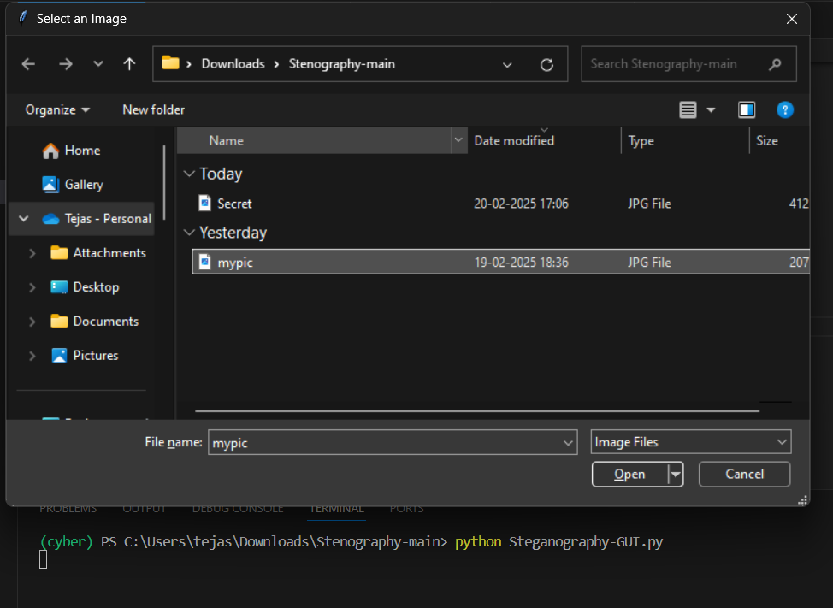
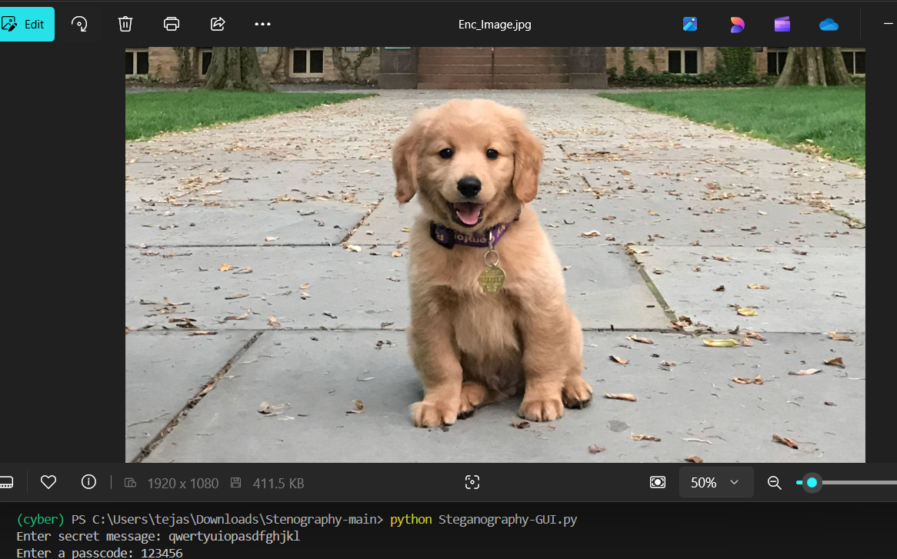
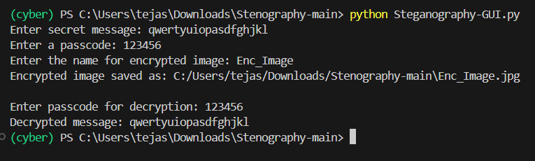
Results

Slide 8
Conclusion
This project addresses the need for secure data transmission in a world where traditional encryption methods can be easily detected. By utilizing steganography to hide sensitive information within digital images, we aim to create a user-friendly system that conceals messages while preserving the original image's integrity.
This approach enhances data security against unauthorized access and tampering, providing a practical solution for individuals and organizations seeking to protect their information in an increasingly digital environment.

Slide 9
GitHub Link
https://github.com/Tejas-Jay/steganography-python/tree/main

Slide 10
Future scope(optional)
The future scope of steganography projects in secure data transmission includes advancements in combining steganography with encryption techniques, enhancing resilience against detection, and optimizing methods for various media formats. Additionally, exploring multi-image and web steganography can further improve data security and transmission efficiency.

Slide 11
THANK YOU

